Slide 1
Atoms Manipulation
Quantum Corrals
Quantum Mirage
PC2232 Lecture 11

Slide 2
Lecture Outline
Introduction
Building Structures Atom by Atom
Quantum Corrals
Mechanism of Atom Manipulation
STM Writing
Quantum Mirage
Useful Reference
“Engineering a Small World: From Atomic Manipulation to Microfabrication.” Special Section in Science
Vol 254, Page 1300-1342, Nov 29, 1991

Slide 3

Richard Feynman
“ Upto now we have been content to dig in the ground to find minerals, …. Ultimately in the great future we can arrange the atoms the way we want.”
“The principles of physics, as far as I can see, do not speak against the possibility of maneuvering things atom by atom.”
“Put the atoms down where the chemist says, and so you make the substance.”
Richard P. Feynman, 1959
Physics Nobel Laureate
The man who dared to think small

Slide 4
The Man Who Dared to Think Small
“Feynman’s talk was so visionary that it didn’t really connect with people until the technology caught up with it”
- Ralph Merkle
Palo Alto Research Center
Many of today’s researcher learned about the lecture only after they were already practicing exactly what Feynman had said.
“I didn’t know about the talk until after I got into the atom-moving business.” , “I felt the ghost of Feynman behind me while I was reading, saying ‘Look, I thought of these things 30 years ago.’”
- Don Eigler, IBM

Slide 5
Using STM to Manipulate Atom
The prospect of manipulating matter on the atomic scale has fascinated scientists for decades.
Advances in STM have made this prospect a reality; single atoms can be placed at selected positions and structures can be built to a particular design atom-by-atom.

Slide 6
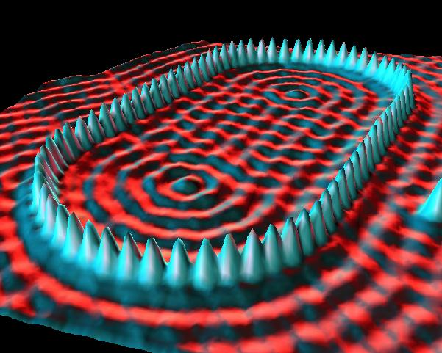
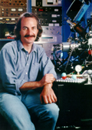
Shaping the World Atom by Atom
Don Eigler IBM
IBM: Quantum Corrals (Stadium)

Slide 7
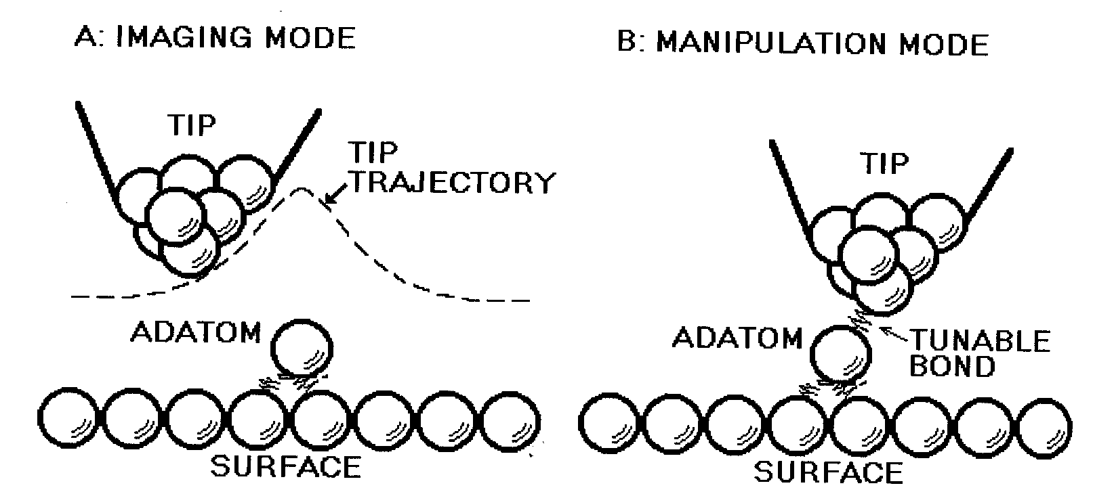
Using STM to Manipulate Atom
Imaging mode: Tip stabilized far enough above the surface so that the interaction between tip and adatom is negligible.
Manipulation mode: Tip brought close enough to adatom to drag the adatom along the surface. The force exerted on the adatom by the tip is due to the partially formed chemical bond between the tip and adatom.
Source: G.Timp-Nanotechnology

Slide 8
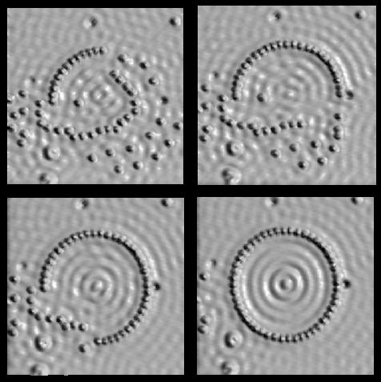
Shaping the World Atom by Atom
Don Eigler IBM

Slide 9
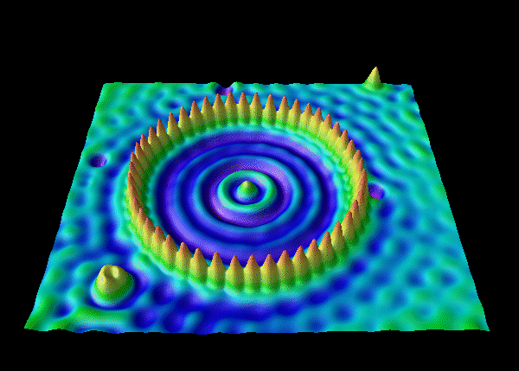

Shaping the World Atom by Atom
What causes the ripple?
Again wavelike property of electron shows up in the quantum world!!!
Don Eigler IBM

Slide 10
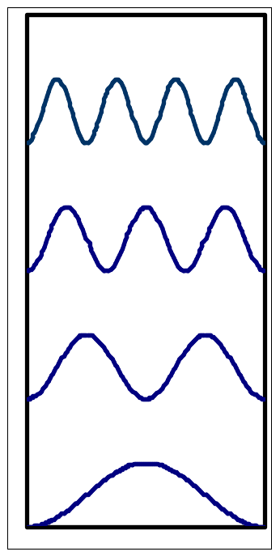
Shaping the World Atom by Atom
Quantum Corral: Iron atoms on copper surface
The copper surface supports surface state which form a two dimensional gas of electrons.
These surface state electrons are trapped in the corral’s interior, forming standing wave states. (just like electron in a potential box!)
The wave structure outside the corral is the standing wave pattern due to the reflection of surface electrons on the exterior of the corral.
Corrals let us study the wave properties of electrons in very small confining structures (something that the electronic device designers of the future will need to know.)
Particle in a box
|Ψn(x)| ²

Slide 11
Using STM to Manipulate
A variety of different manipulation processes have been demonstrated with the STM. These processes may be divided into two classes:
(1) Parallel Processes – adsorbed atom or molecule is induced to move along the surface.
(2) Perpendicular Processes – atom or molecule is transferred from the surface to the tip of the STM or vice versa.

Slide 12
Moving Atoms Using STM
(Parallel Process)
Becomes

Slide 13
Mechanism of Atom Manipulation
Parallel Process: processes in which the motion of the manipulated adsorbate atom or molecule is parallel to the surface
(1) Sliding Process
(2) Field-Assisted Diffusion

Slide 14
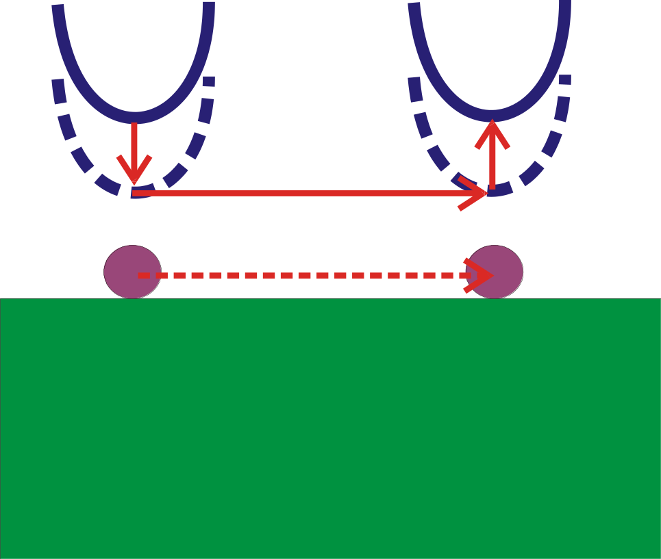
Parallel Process
Sliding Process
Sliding process: pulling the adsorbate atom across the surface with the tip.
Carried out by Steps a,b,c,d,e
(a) Atom located and tip lowered to position (b), atom-tip attractive force is sufficient to keep the atom beneath the tip when tip is subsequently moved across the surface (c) to desired destination (d). Finally tip is withdrawn to (e) where tip-atom interaction is weak, leaving the atom bound to the surface.
a
e
b
c
d
Adsorbed Atom
Surface

Slide 15
Parallel Process
Field-Assisted Diffusion
In STM, the gap between tip and sample is very small (~ 5A). And electrical potential is typically applied to either the tip or the sample (~1V to 10 V). This result in the presence of intense electric field between the probe tip and the surface.
This field is inhomogeneous and concentrated in the vicinity of the probe tip.
Field-assisted manipulation of the atoms is possible where the interaction of the spatially inhomogeneous electric field with the atom on the surface can lead to a potential energy gradient, or force along the surface, which results in a field-assisted directional diffusion of the surface atom.

Slide 16
Parallel Process
Potential energy experienced by an atom on a surface
Physical Structure
Potential Energy

Slide 17
Parallel Process
Field-Assisted Diffusion
Biased Tip
Physical Structure
Potential Energy
The interaction tip electric field with the adatom give rise to a broad potential well where the atom would feel a force to move it to the bottom of the well under the apex of the tip.

Slide 18
Moving Atoms Using STM
(Perpendicular Process)
Becomes

Slide 19
Mechanism of Atom Manipulation
perpendicular Process
(1) Transfer On- or Near-Contact
(2) Field Evaporation
(3) Electromigration

Slide 20
Perpendicular Process
Transfer On- or Near Contact
Conceptually the simplest of the atomic manipulation process.
Tip moved towards the atom on the surface until the atom is bonded.
Tip withdrawn and carries the atom with it. (if the force of attraction between tip and atom is stronger than that between atom and surface.)
Works on system with Xe atoms on Pt or Ni surface.

Slide 21
Perpendicular Process
Field Evaporation
Evaporation of ions from the surface by the application of an electric field.

Slide 22
Perpendicular Process
Electromigration
The flow of electrical current can induce the migration of impurities or other defects through the bulk of a solid. This process is known as electromigration.
The force on the defects is due to direct interaction of the effective charge on the defect with the electric field and due to the scattering of electrons at the defects.
In an STM, these forces should be most strongly felt by the atoms in the immediate vicinity of the tunnel junction where the electric field and the current density are greatest.

Slide 23
A Tool for Science
What can we do with this technique?
(1) Modify STM tip to yield high resolution image
(2) Make a linear chain of atoms and study their interaction
(3) Creating “custom” made structures.

Slide 24
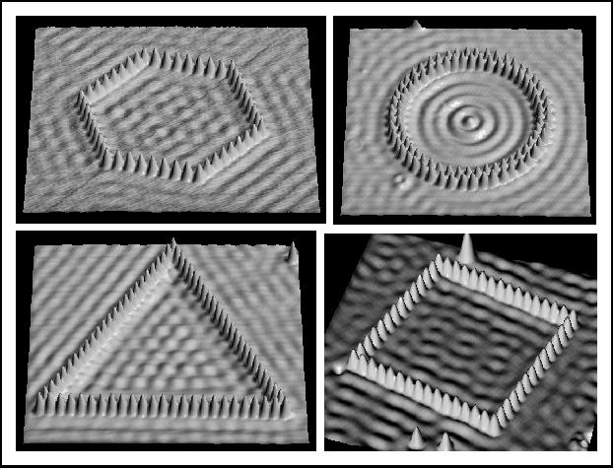
Shaping the World Atom by Atom
Don Eigler IBM

Slide 25
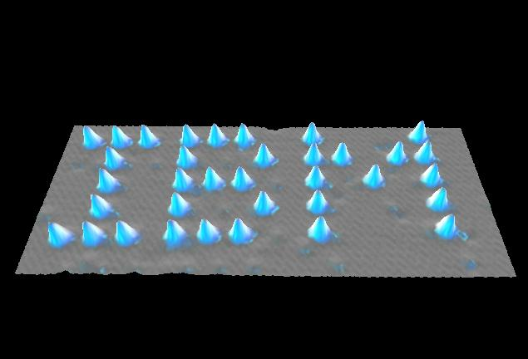
World’s smallest Writing
~ 3 nm
Nano_advertisement
We can write 260,000,000 pages of Encyclopedia Britannica on a pin head !!!
Don Eigler IBM

Slide 26
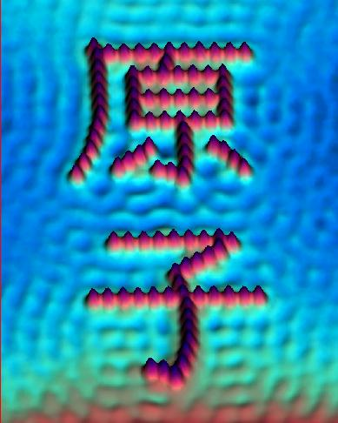
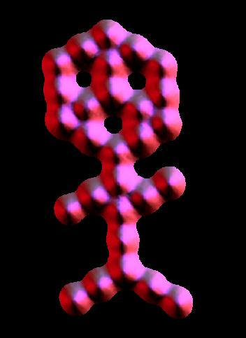
Shaping the World Atom by Atom
IBM: Carbonmonoxide Man
Don Eigler IBM

Slide 27
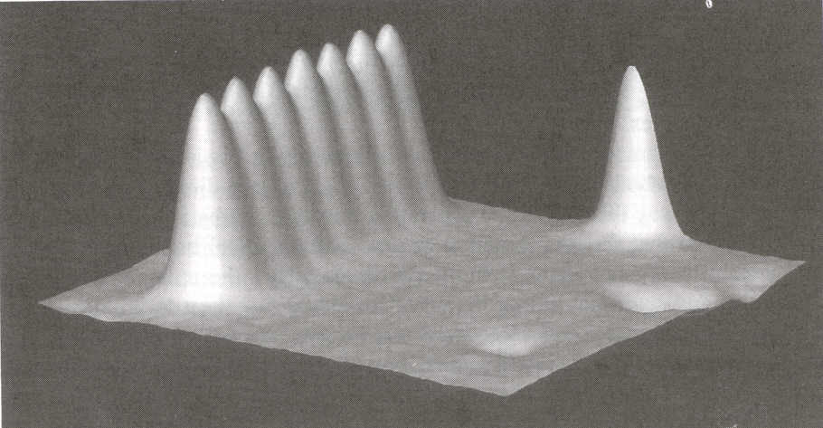
Shaping the World Atom by Atom
IBM
A row of seven xenon atoms constructed with the STM.
The xenon atoms are spaced apart (5 Angstrom) every other atom of the underlying nickel surface. The xenon atoms cannot be packed together any tighter and remain in a single row.
We can study the strength of xenon-xenon interaction relative to the strength of interaction between xenon atoms and the underlying nickel atoms.
Here Xe-Ni interaction is stronger than Xe-Xe interaction.

Slide 28
Quantum Mirage

Slide 29
What is an Ellipse?
x²
y²
+
= 1
Foci
a²
b²

Slide 30
Ellipse
Light emitted from one focus will be reflected onto the other focus.

Slide 31
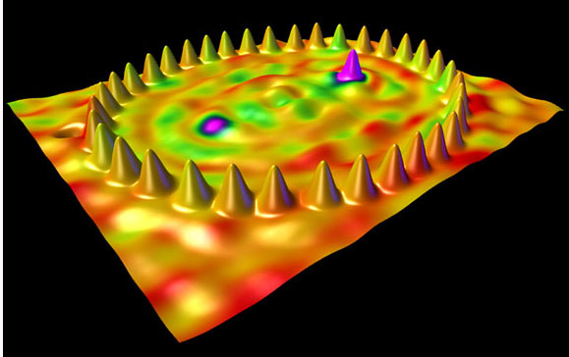
Quantum Mirage
IBM, Manoharan, Lutz and Eigler Nature 3 February 2000
A STM was used to position 36 Cobalt (Co) atoms in an elliptical structure known as a “quantum corral.” Electron waves moving in the copper substrate interact both with a magnetic cobalt atom carefully positioned at one of the foci of the ellipse and apparently with a “mirage” of another cobalt atom (that isn’t really there!) at the other focus.

Slide 32
Quantum Mirage
When a magnetic Cobalt atom (Co) is placed at a focus point of an elliptical corral , some of its properties also appear at the other focus, where no atoms exists!!
The property detected in this case is related to the magnetism of the Co atom.
When the cobalt atom is placed elsewhere within the ellipse but not at a focus point, the mirage disappear. The magnetism is only detected at the Co atom.
This projection of information from an atom to another place where there is no atom was named the “Quantum Mirage” by Manoharan, Lutz and Eigler (IBM).
IBM, Manoharan, Lutz and Eigler Nature 3 February 2000

Slide 33
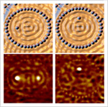
Quantum Mirage
Due to Co atom
Due to Co atom
Mirage
No Mirage here
IBM, Manoharan, Lutz and Eigler Nature 3 February 2000

Slide 34
Quantum Mirage
“This is a fundamentally new way of guiding information through a solid.”
Don Eigler
This is a new way to transport information at atomic scale that uses the wave nature of electrons instead of conventional wiring.
“We have become quantum mechanics – engineering and exploring the properties of quantum states. We are paving the way for the future nanotechnicians.”
IBM, Manoharan, Lutz and Eigler Nature 3 February 2000

Slide 35
STM Writing by Way of
Removal of Atoms
Reference: “Surface modification of MoS₂ using an STM”
Applied Surface Science Vol 60-61, page 643-647, 1992
Shigeyuki Hosoki, Sumio Hosaka and Tsuyoshi Hasegawa,
Central Research Laboratory, Hitachi Ltd.

Slide 36
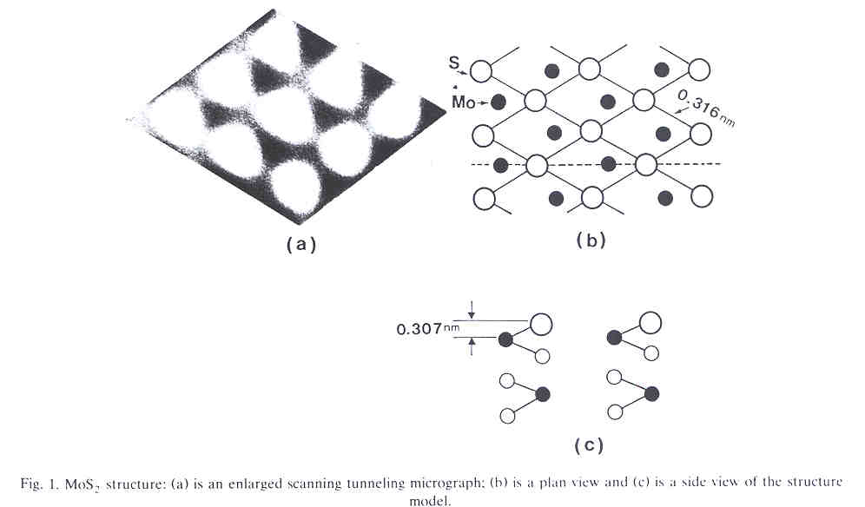
STM Writing: MoS₂ Surface
Source: Applied Surface Science Vol60-61, 643-647, 1992

Slide 37
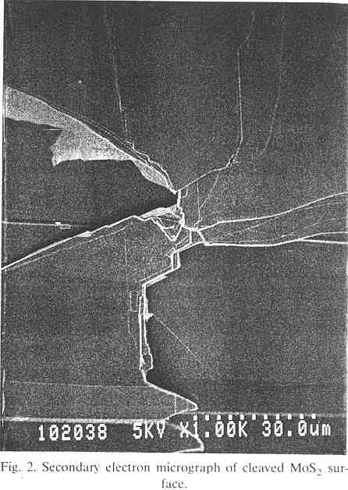
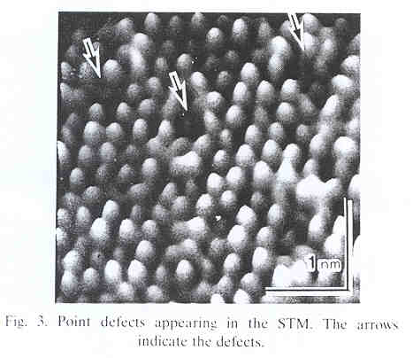
STM Writing: MoS₂ Surface
Point defects appearing in the STM. The arrows indicate the defects.
Secondary electron micrograph of cleaved MoS₂ surface
Source: Applied Surface Science Vol60-61, 643-647, 1992

Slide 38
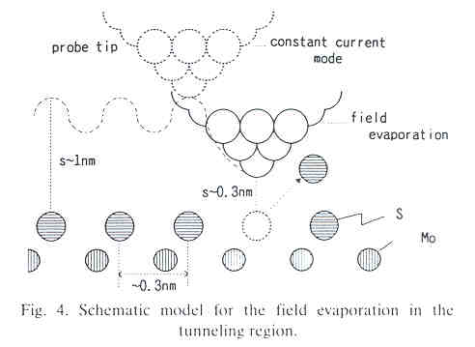
STM Writing: Field Evaporation
Schematic model for the field evaporation in the tunneling region
Source: Applied Surface Science Vol60-61, 643-647, 1992

Slide 39
STM Writing: Field Evaporation
During observation, scanning and traveling to the pointed atom, the probe tip was kept at 1 nm from the specimen surface. The bias of the tip was 0.1 V.
When it was positioned directly over an atom to be detached, it was brought to 0.3 nm of the surface and a higher voltage pulse (tip: -5 V to sample 0 V, pulse 70 millisecond, effectively) than that used for observation.
After the removal of an atom, the probe tip was moved to an adjacent sulfur atom and delivered a second pulse.
Source: Applied Surface Science Vol60-61, 643-647, 1992

Slide 40
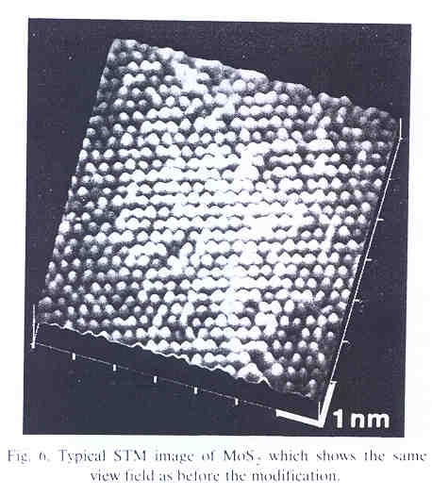
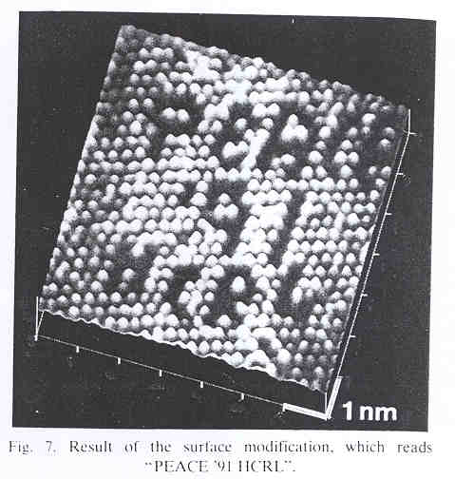
World’s Smallest Writing Too!
Typical STM image of MoS2 which shows the same field of view as before the modification.
Result of the surface modification, which reads “PEACE ’91 HCRL”
Source: Applied Surface Science Vol60-61, 643-647, 1992

